Slide 1
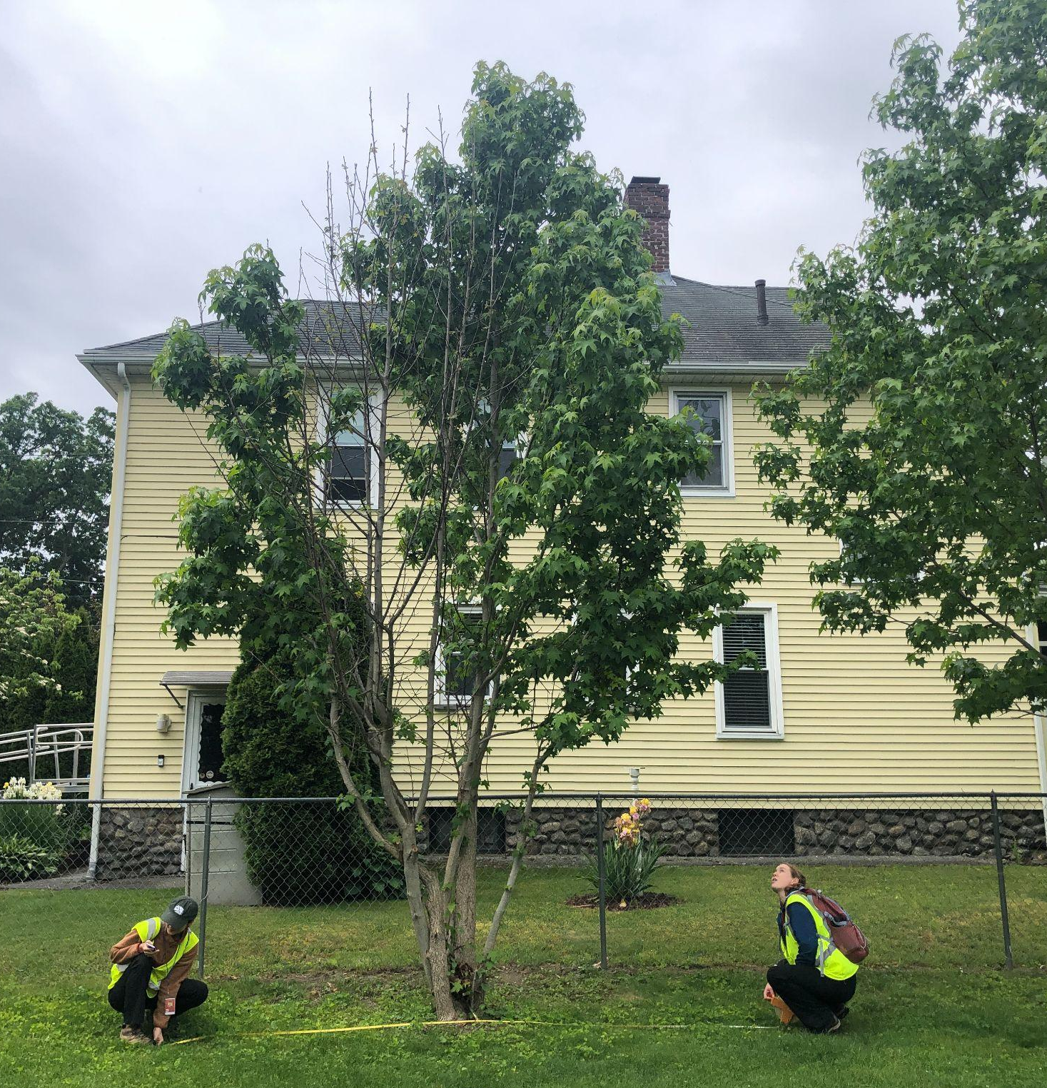




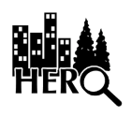
Human Environment Research Observatory (HERO)
2023 Internship Presentation
Jason Andrews & Clio Bate

Slide 2
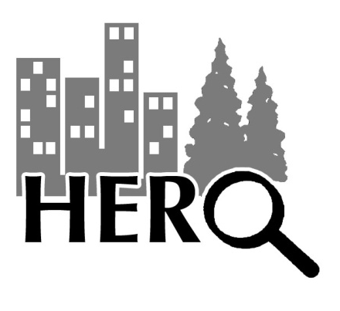
What is HERO?
HERO is an urban forestry research program run by Clark University that undertakes a different tree survey every summer with a group of undergraduate fellows.
We work closely with MA DCR (Department of Conservation and Recreation) foresters and project managers to assess research needs, and receive relevant training
HERO is currently run by professors Deborah Martin and John Rogan
1999 Year one (David Angel and BL Turner)
24 Years in operation
192 Undergraduate students mentored
https://www.clarku.edu/departments/hero-program/
Funding provided by the John T. O’Connor ‘78 Fund

Slide 3
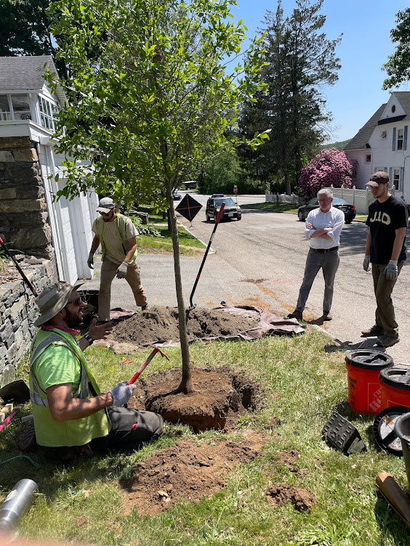
General Urban Forestry Questions:
What policies best support the multiple aspects of planting and stewardship for tree survivorship?
How, where and why do trees planted remain healthy and vigorous on public and private property?
- How, where and why does tree canopy mitigate air temperature/pollution?
- What are the best situations for heat mitigation in environmental justice communities?

Slide 4
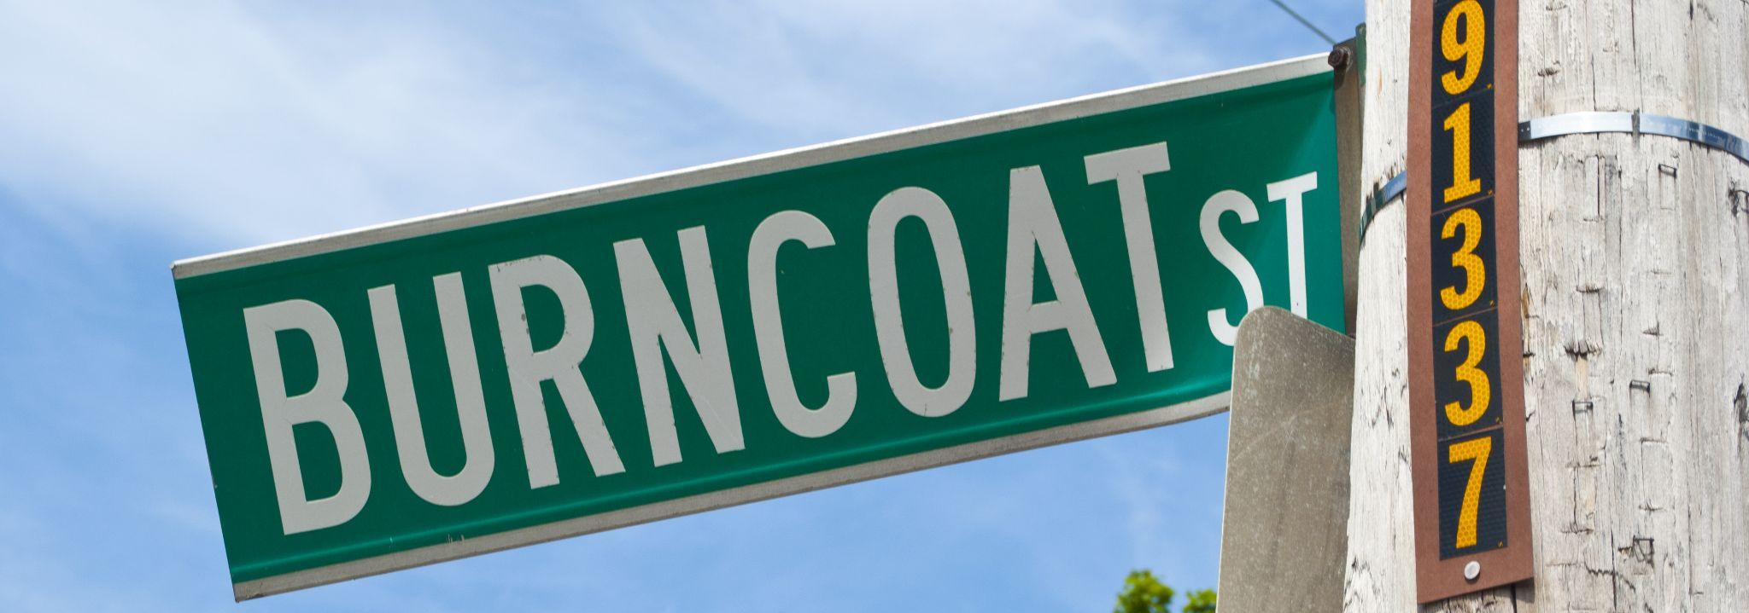
Study Objectives: Summer 2023
Assess the success of the tree planting program that followed long horned beetle removals from 2010-2012
Background:
Nearly 35,000 trees were removed following the discovery of long horned beetle in the Worcester area.
The DCR immediately attempted to plant trees to regain the lost canopy and ecosystem services.
Research Questions:
What is the current status of tree health and structure compared to the past HERO tree survey?
What factors have the greatest impact on tree health and structure?
How do residents perceive the role of trees and DCR’s tree planting initiative on their property and in their neighborhood?
How do past experiences and beliefs of residents impact tree stewardship?
Notes:
Put years in instead of “10 years ago”, cut out “for reasons below”... rewrite research questions. “What are the factors that influence tree health and survivorship after 10 years”, “what do residents have to say about…”
Other questions:
How effective was the DCR’s tree planting initiative?
How much has the study area changed since 2014-16?
Sub questions for Objective 1, Question 1
site type and land use
neighborhood
Stewardship
native/non-native/tree type/drought tolerance (species characteristics?)
new homeowners
Sub questions/dimensions of change for Objective 1, Question 2
Width (tree cover)
Height
Survivorship
DBH

Slide 5

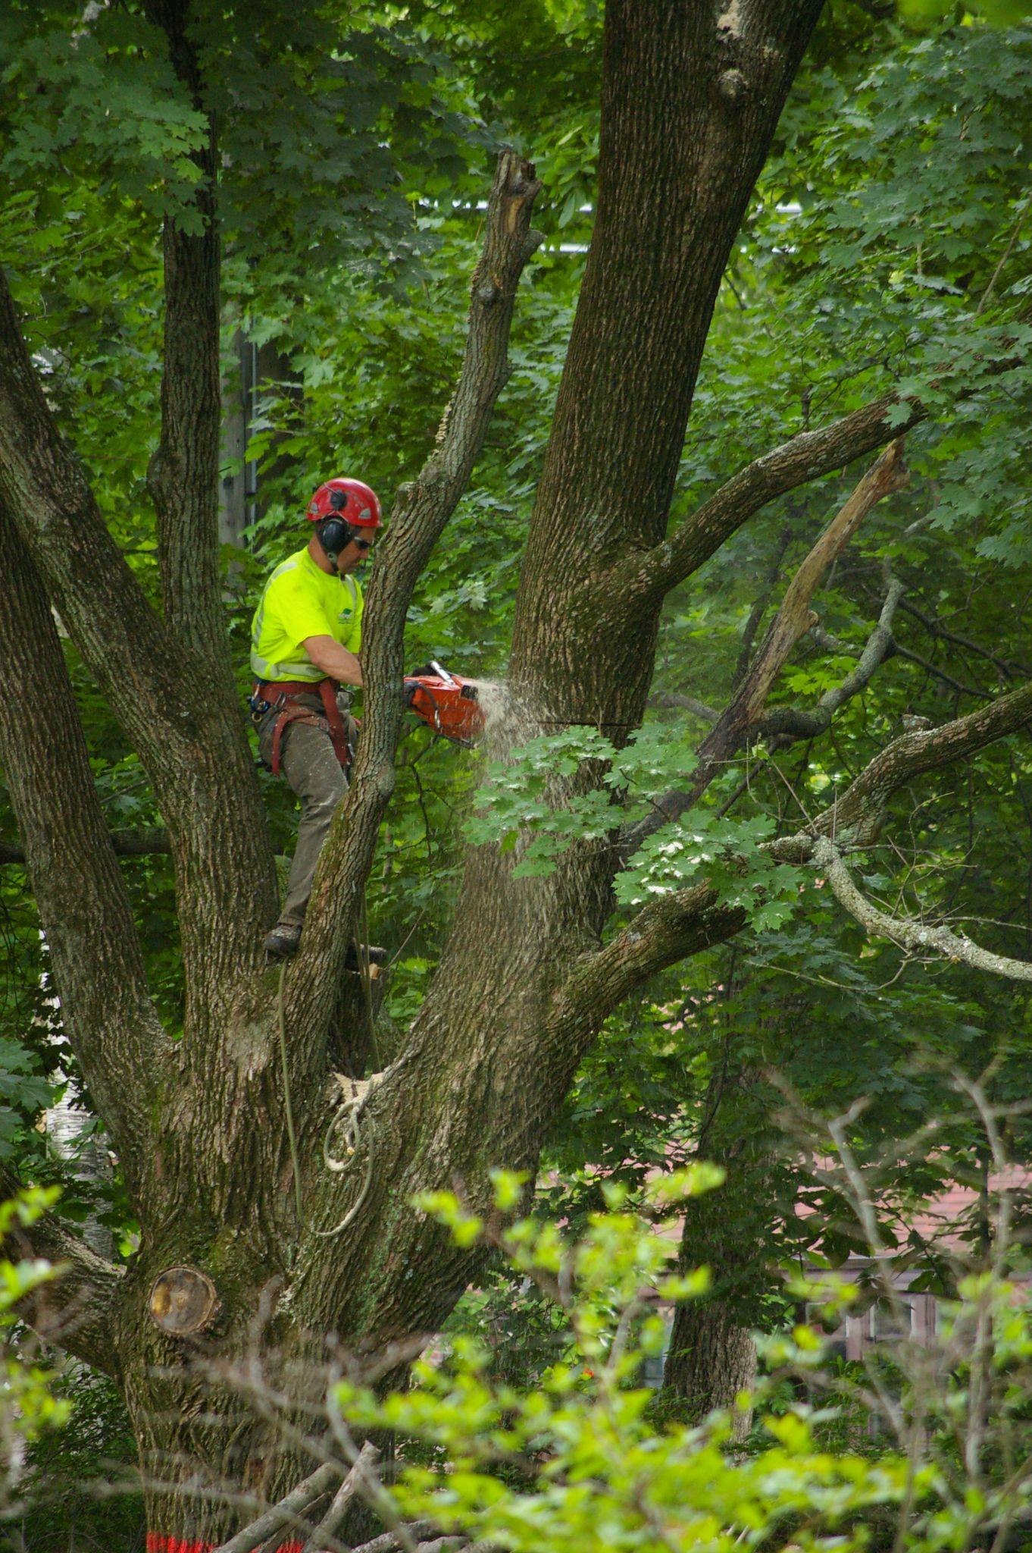
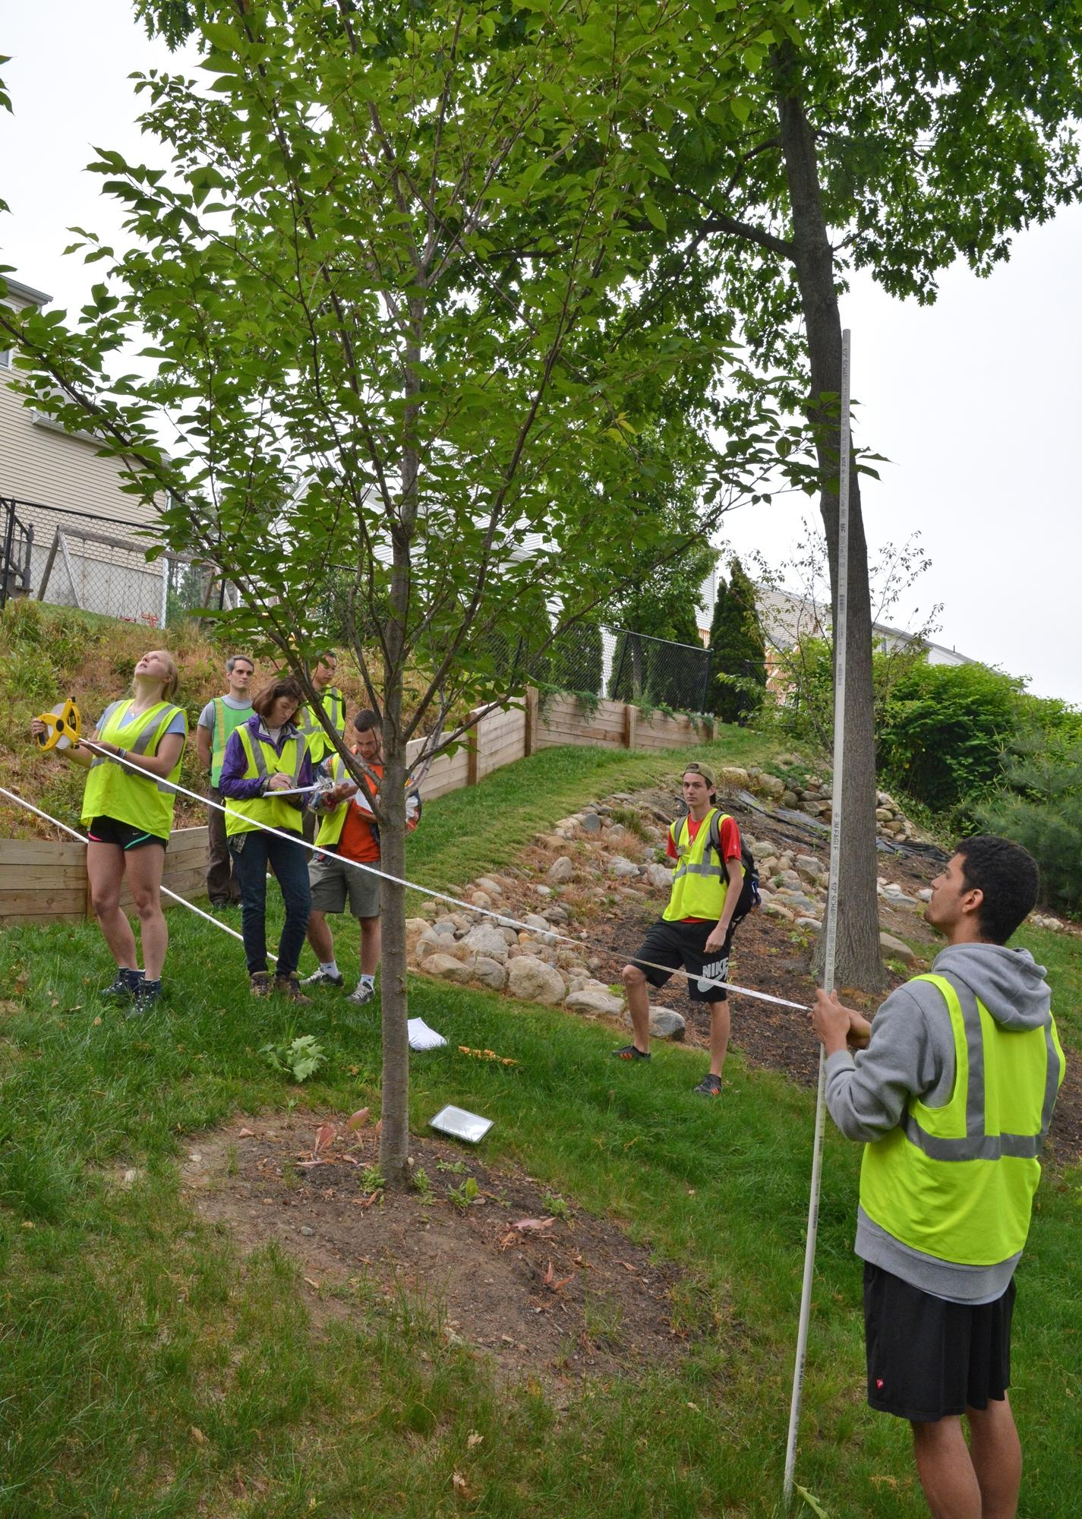
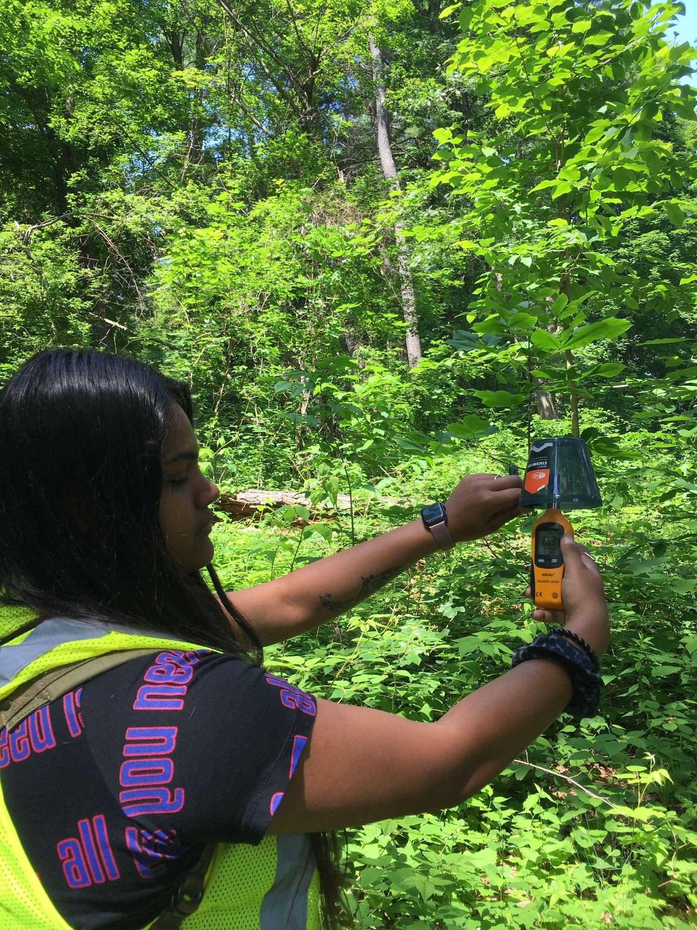
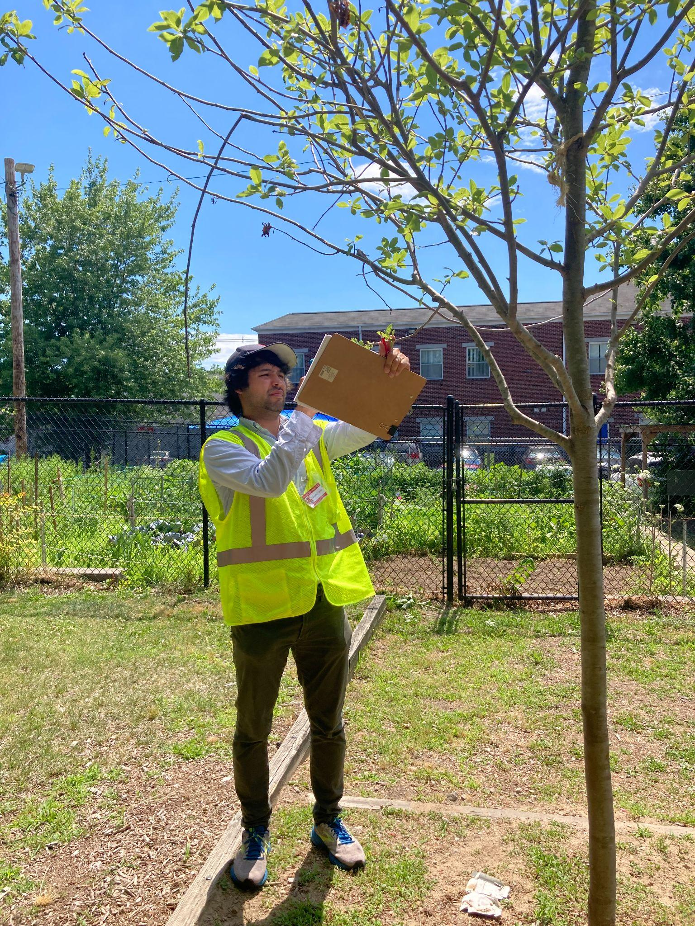
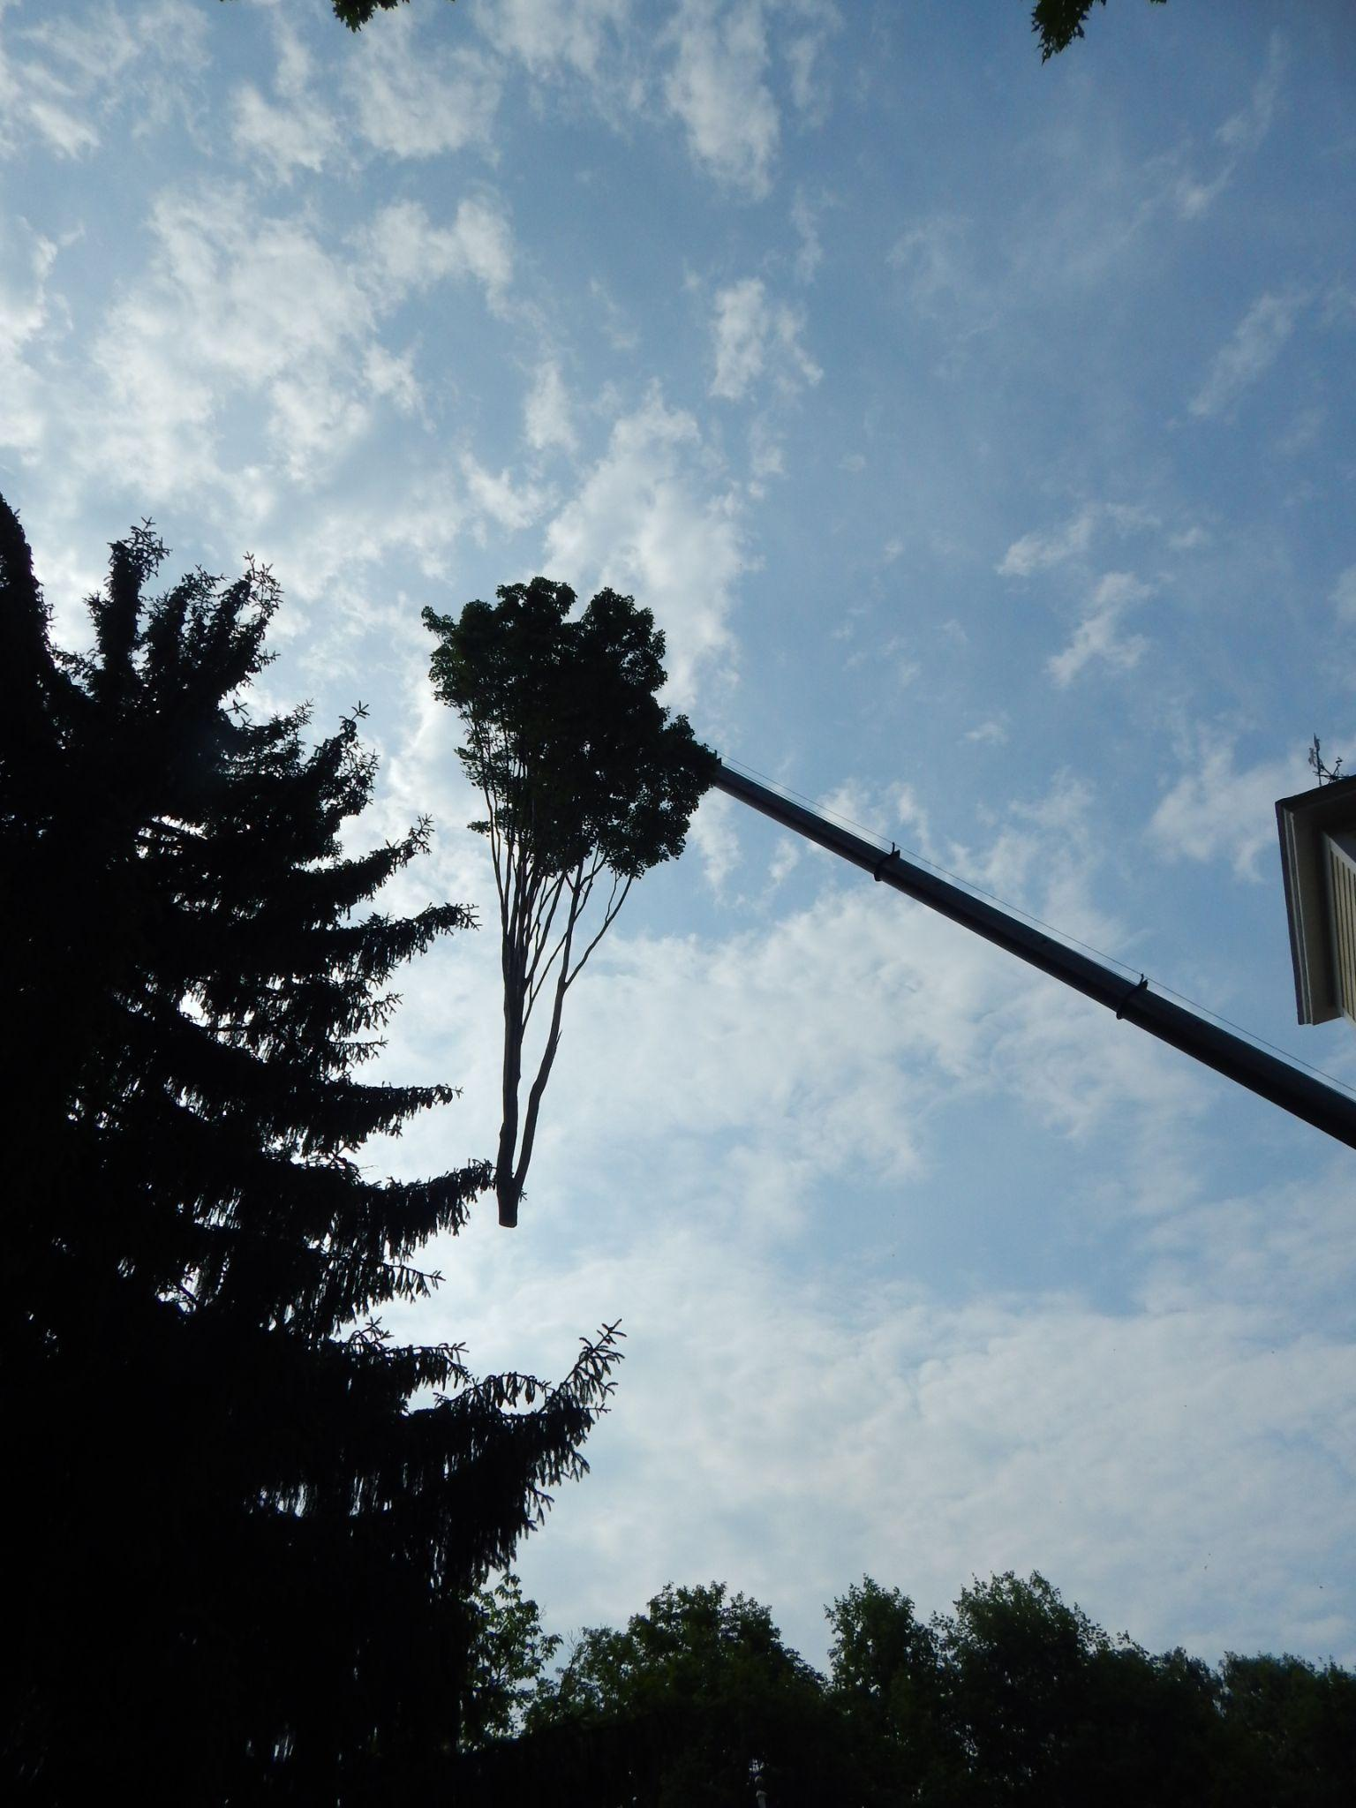
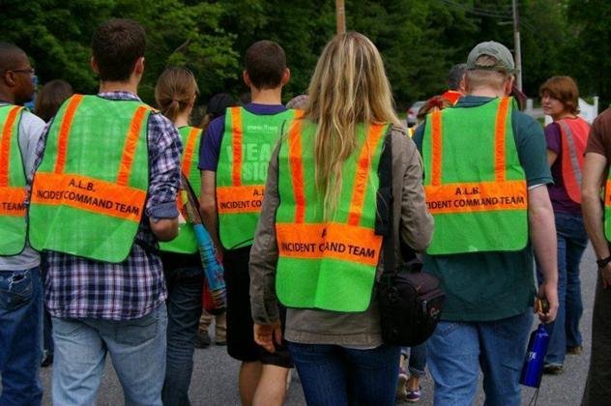
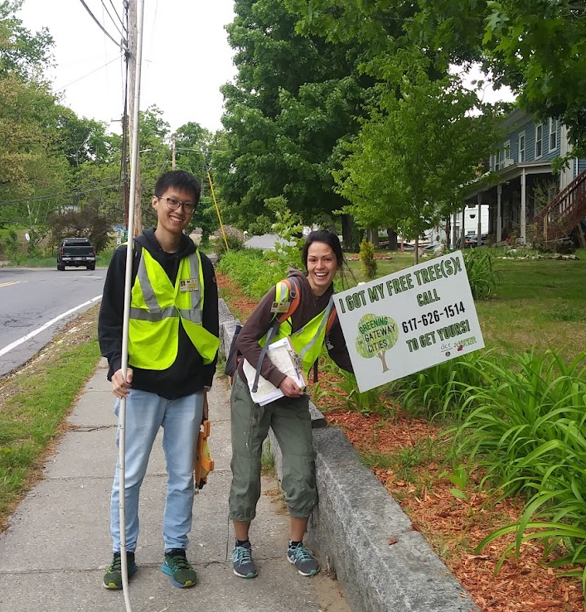
Longhorned Beetle in Worcester: HERO Research History
HERO joins collaboration with USDA and DCR
HERO partners with GGC
2008 2012 2014 2017 2022
LB eradication program
begins
HERO begins survey in
LB study area
HERO studies juvenile tree health, air quality, and stewardship
Notes:
Smaller beatle, more pictures/icons instead of words. Show all years

Slide 6
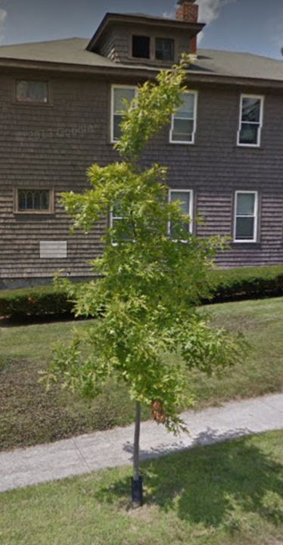
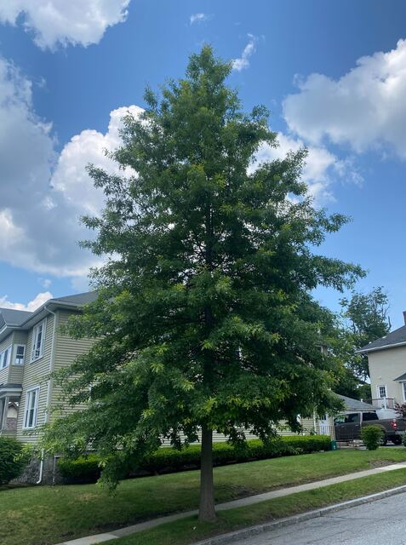
Tree Benefits: Past HERO Research Contributions
Temperature impacts
10% increase in impervious surface = 1.66°C increase in land surface temperature
(Rogan et al., 2013)
Summer warm period was extended in tree canopy loss areas by 15 days
(Elmes et al., 2017)
Policy contributions
12 ft
43.4 ft
Economic benefits
State funding and coordination of tree stewardship can enhance survivorship
(Breger et al., 2019)
Tree planting density of three trees per acre achieved the largest energy savings
(Moody et al., 2021)
Residents who are policy actors have high residential tree survivorship
(Geron et al., 2023)
$1520 in total annual energy savings per town
(Moody et al., 2021)
2 inch DBH
11.1 inch DBH
Increase property value
(Healy et al., 2022)
Pin Oak (Quercus palustris) planted by the DCR in 2011 on Dorothy Ave as photographed in 2014 and 2023
Notes:
Look at stats on posters on the HERO lab walls/past HERO research

Slide 7
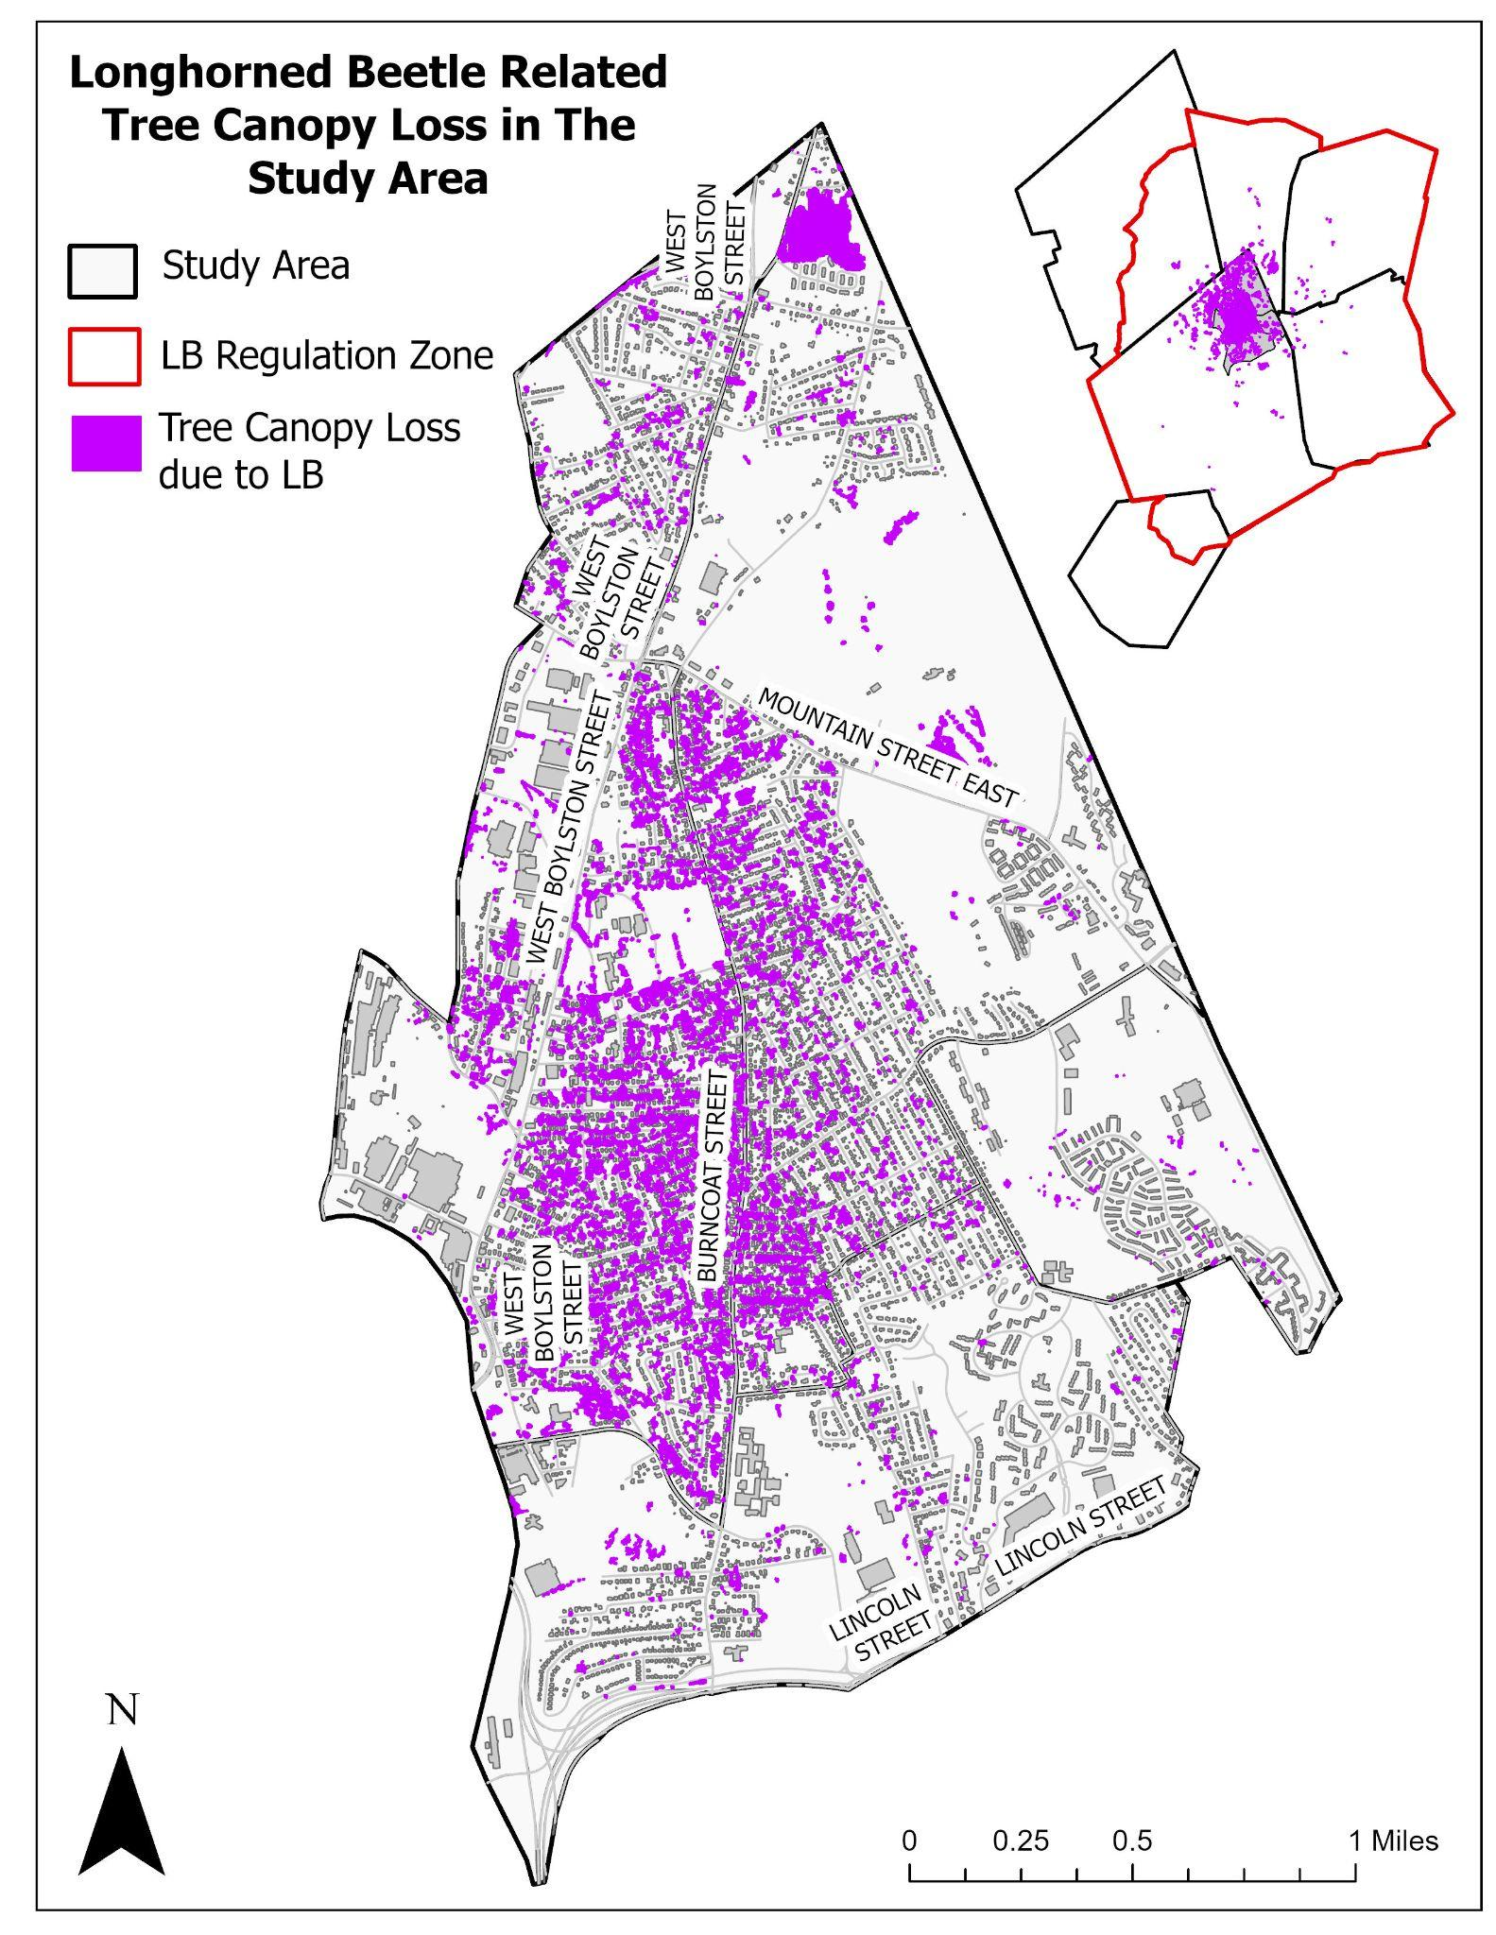

Summer 2023 Survery Background: LB Removals
Longhorned Beetle found in Worcester in 2008
Worcester’s urban canopy is contiguous with the hardwood forest of the Northeast
337 sq km regulation zone enacted around the infested area
Massive tree cutting program planned by the USDA working with the DCR (Bond & Harless 2008)
~34,196 trees removed by Oct 2014
At the time, was the largest US infestation in terms of trees removed
Greendale
Notes:
25,000 just from Burncoat and Greendale
Impacts of tree removal (Danko): tree removal destabilizes soil, destroys wildlife habitats; increases vulnerabilities to flooding and windstorms
City: air pollution, land surface temp, exposure to extreme temp;

Slide 8
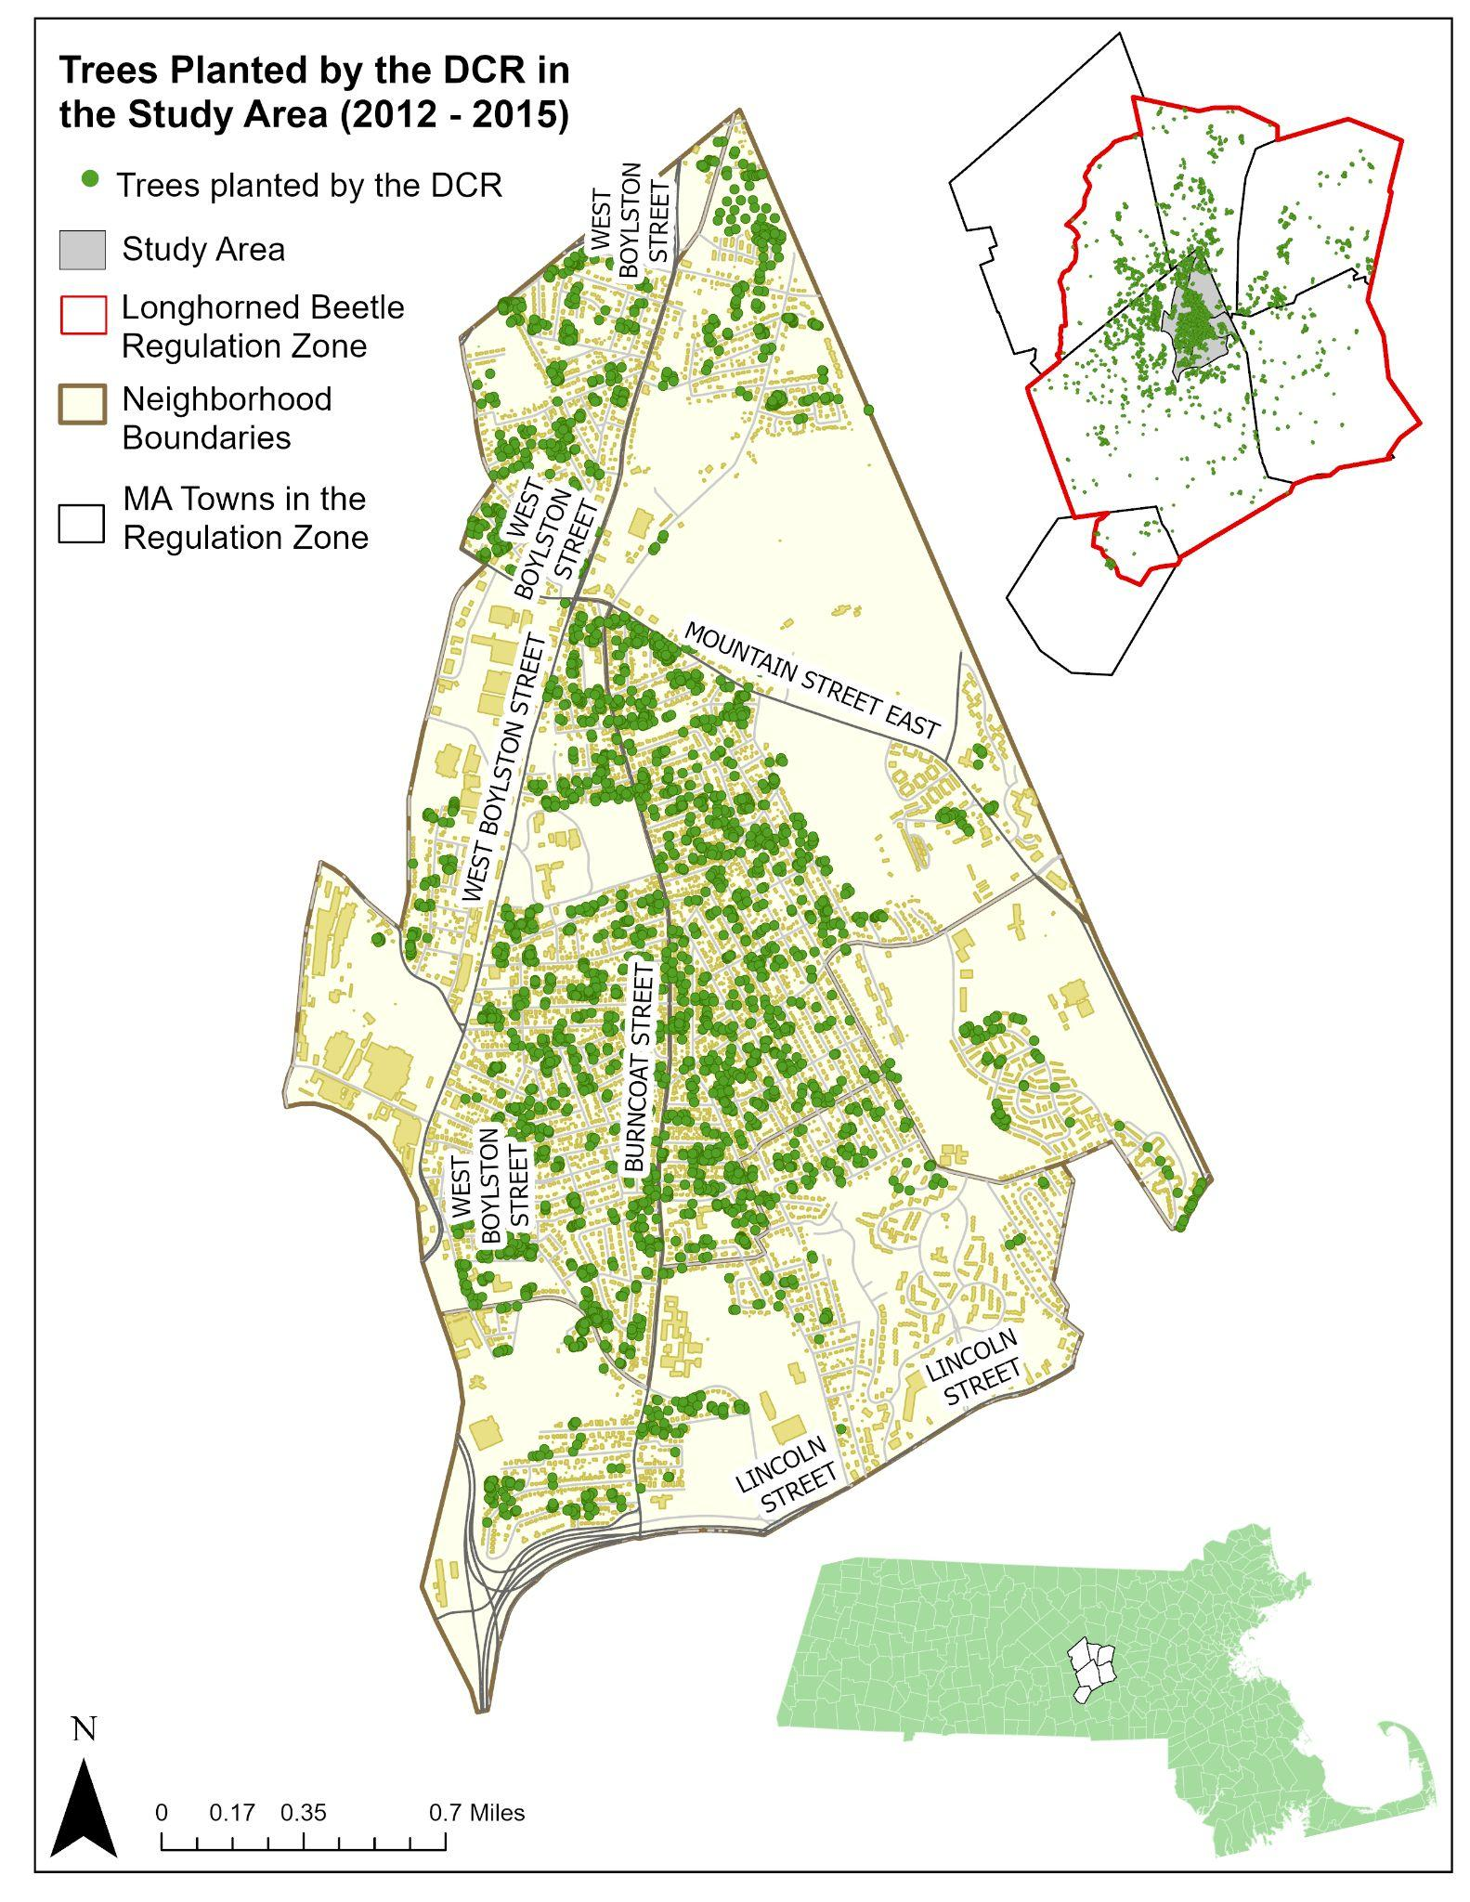
DCR Longhorned Beetle Tree Planting Program
The DCR’s tree planting program planted 17,000 trees to rebuild the region’s urban canopy
2,381 trees planted in our study area
Tree planting began in spring 2010 and continued until 2017
Funded by the American Recovery and Reinvestment Act (ARRA)
Sourced trees from Bigelow Nursery
Many arborvitae were planted to keep up with the large demand for trees

Slide 9
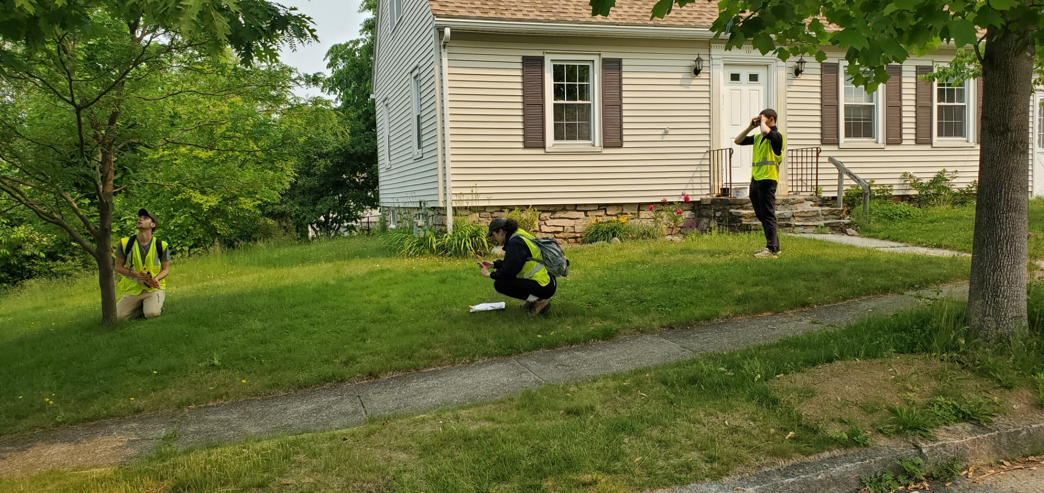
Graduate Research Manager Responsibilities:
Organize, and manage day to day logistics of tree survey work
Big picture research questions— data analysis in R, ArcPro, GEE

Slide 10
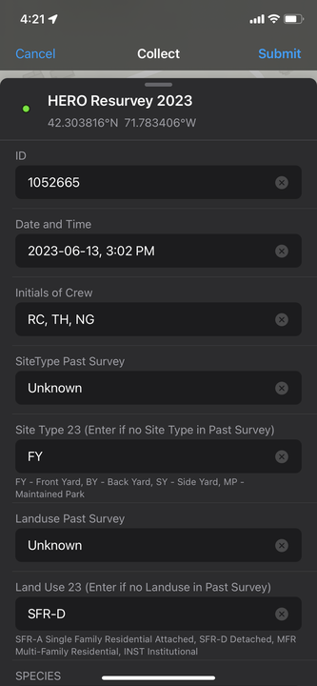
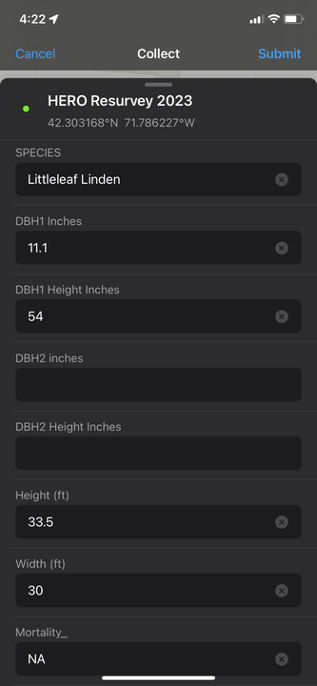
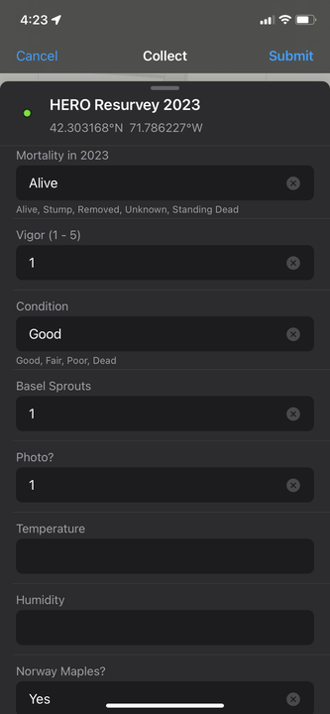
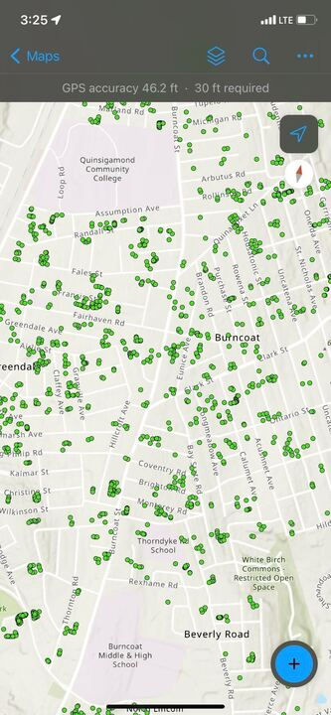
A big part of the summer was working in Arc FieldMaps

Slide 11
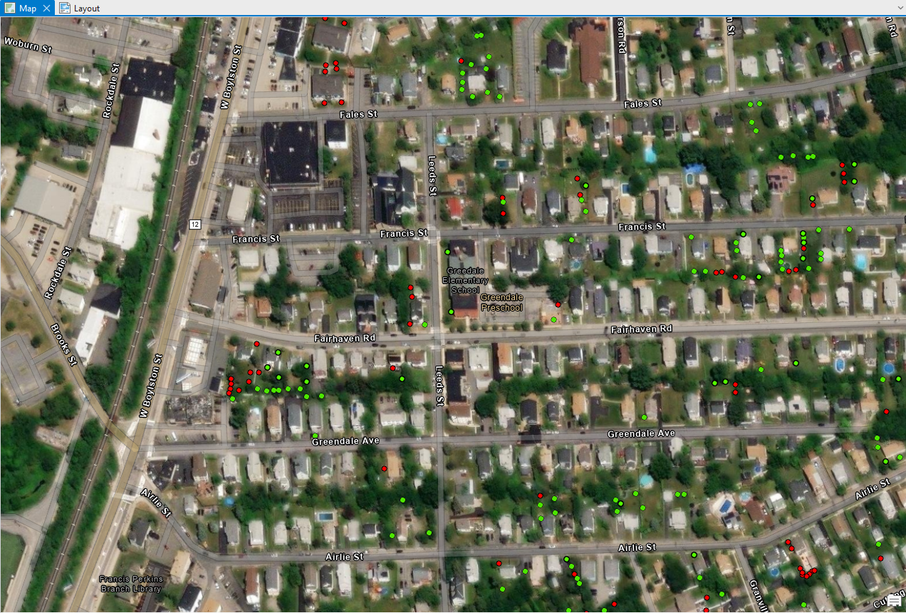
And importing the data into ArcGIS Pro for Analysis

Slide 12
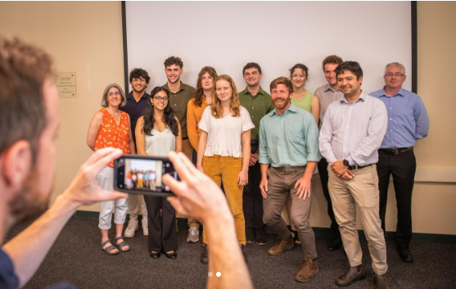
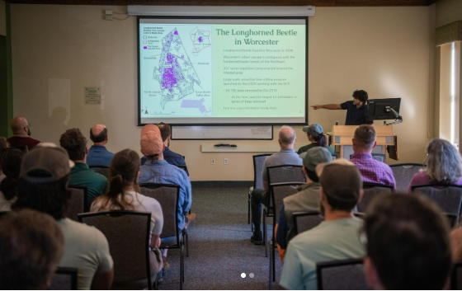
Final product was a slideshow presentation for DCR and other stakeholders

Slide 13
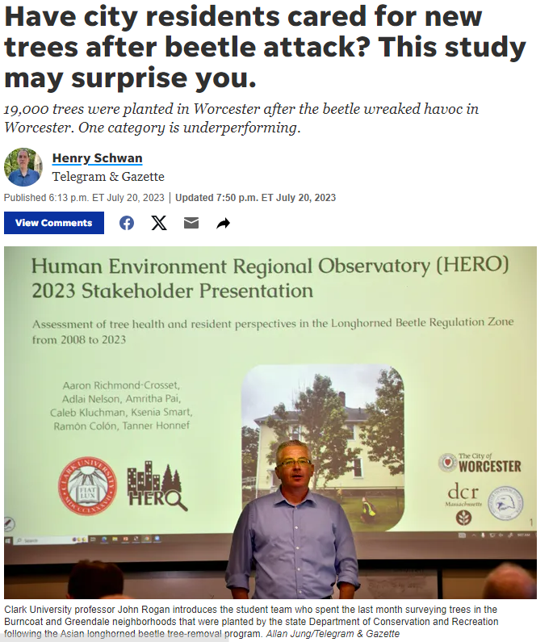
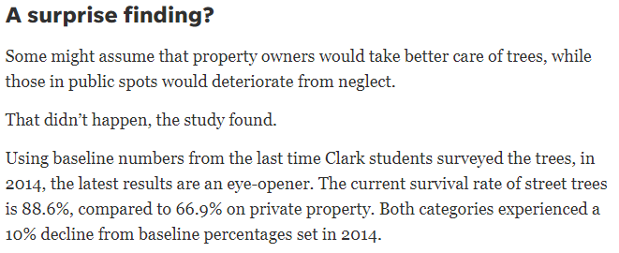
It was interesting to see how the Telegram-Gazette covered the story and interpreted the data we presented

Slide 14
Here are some examples of Data Analysis…

Slide 15
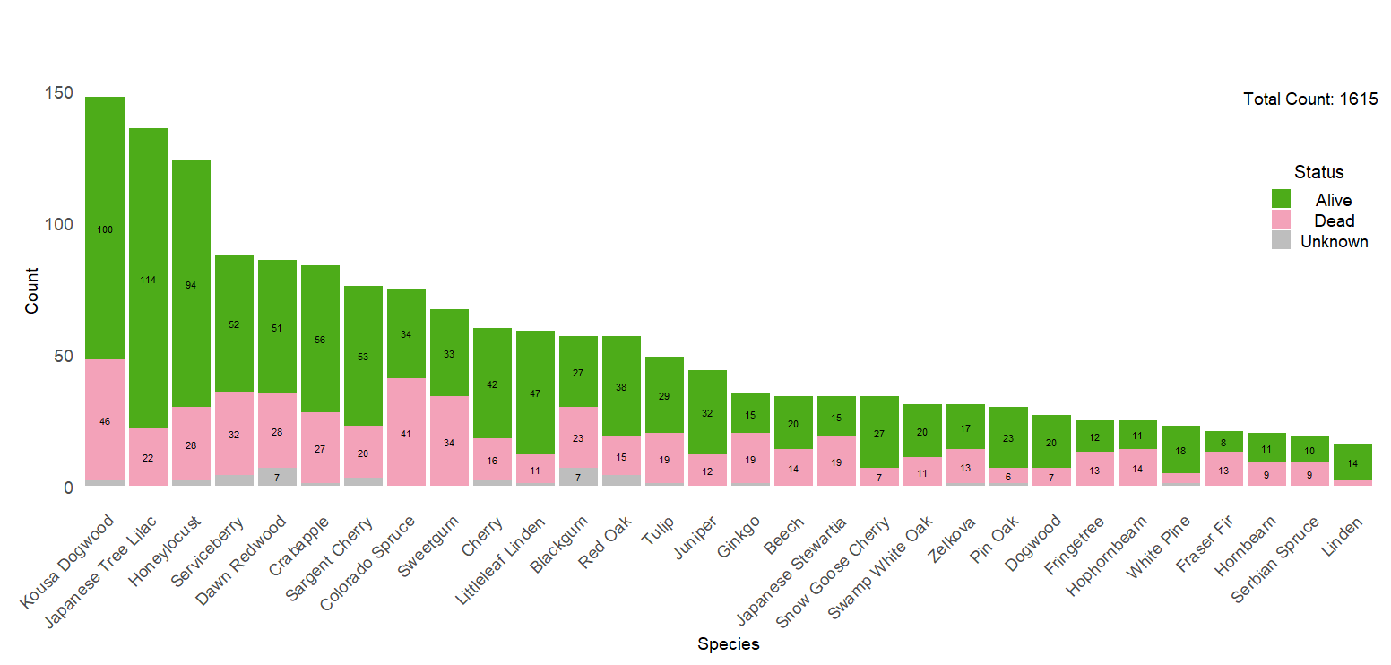
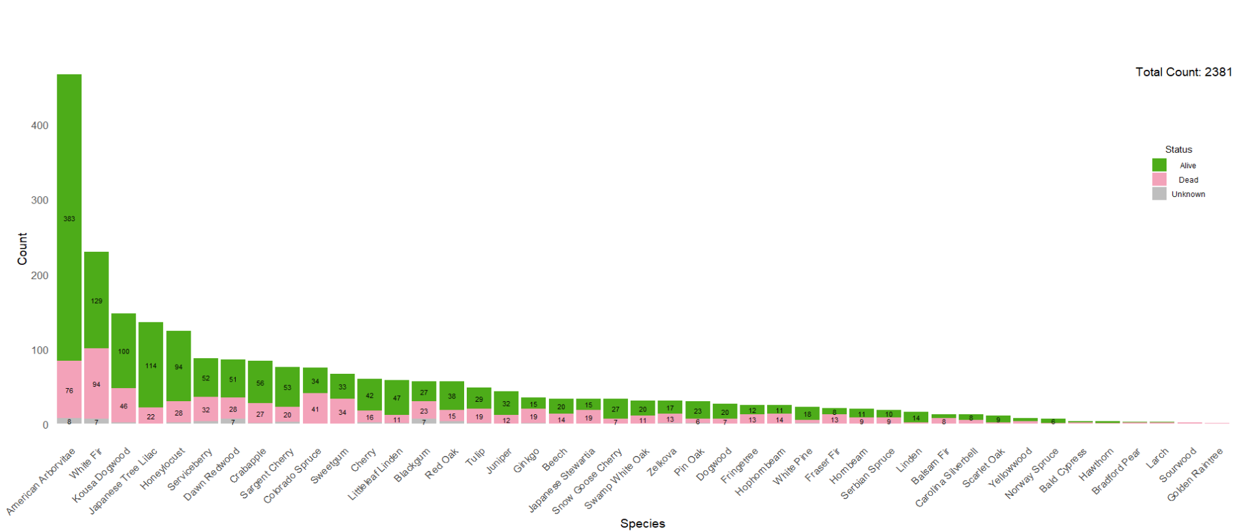
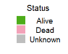
Private Tree Species’ Survivorship by Count
Reduced Count: 1615
Total Count: 2381

Slide 16
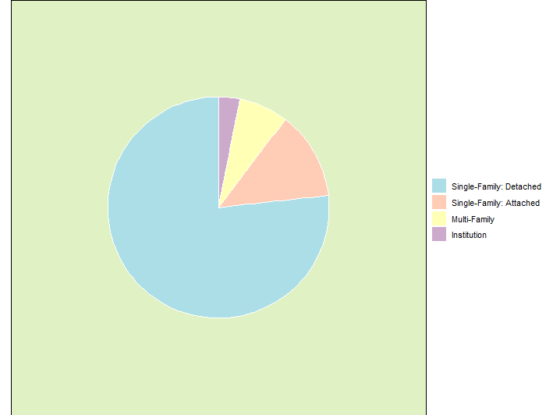
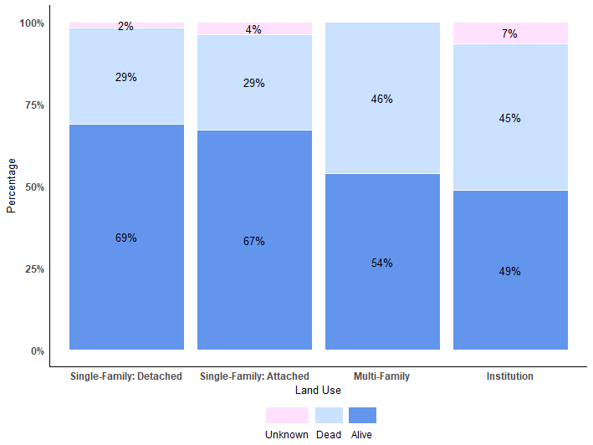
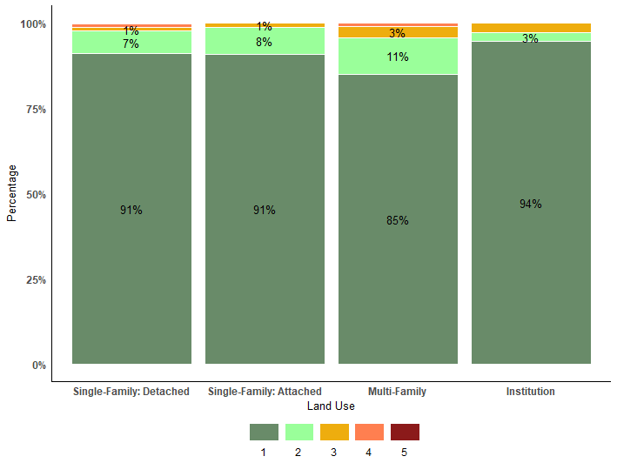
Health By Land Use
Of Trees Surveyed (2023)
Single-Family: Detached (76.7%)
Single-Family: Attached (12.9%)
Multi-Family (7.3%)
Institution (3.1%)
Mortality
Vigor

Slide 17
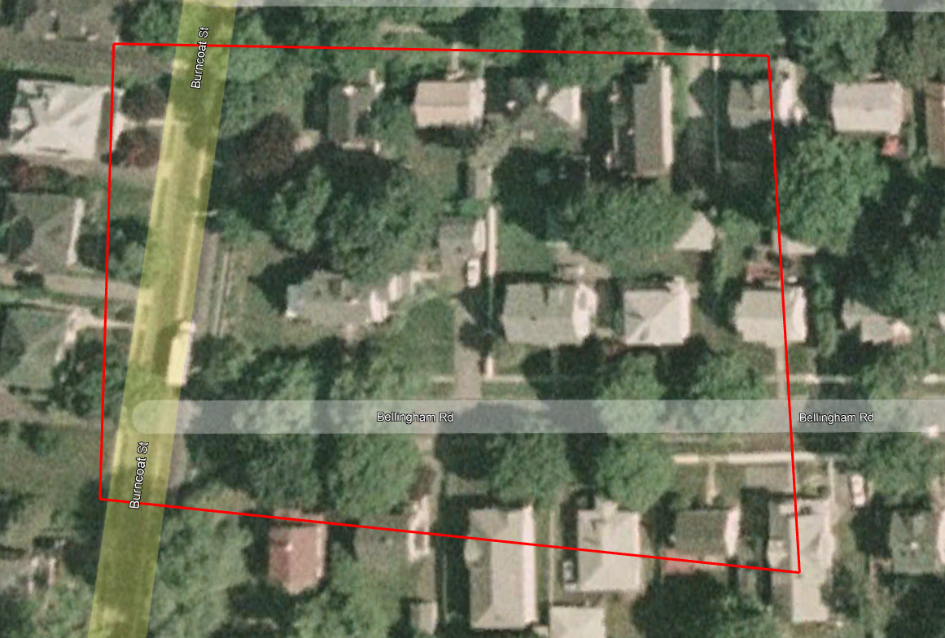
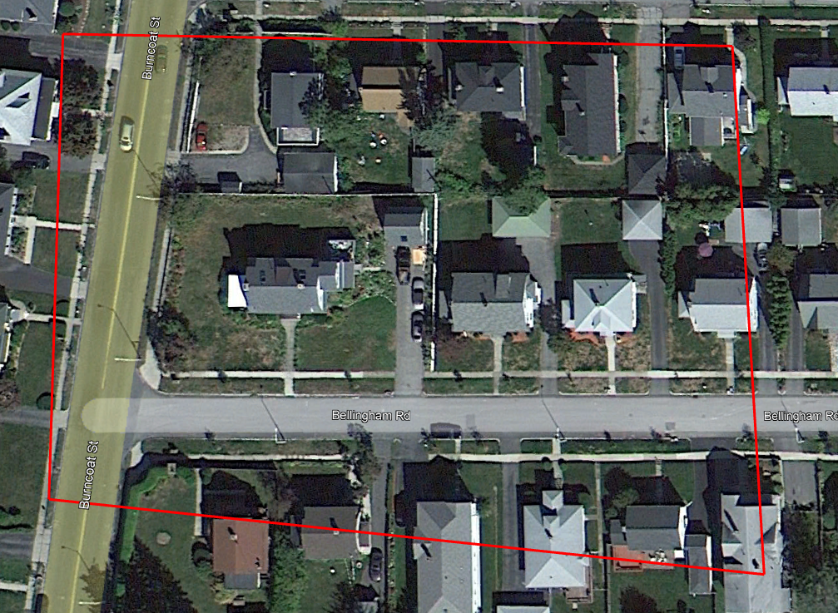
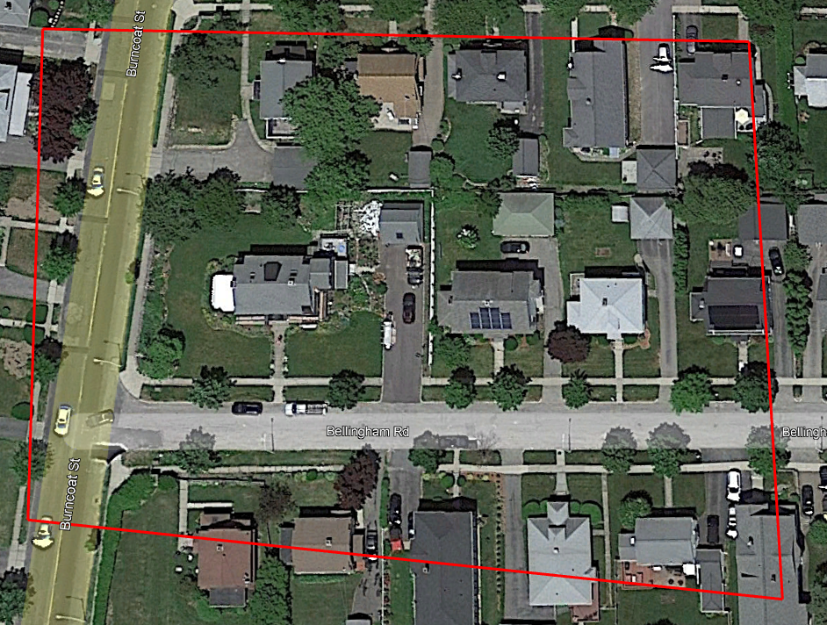
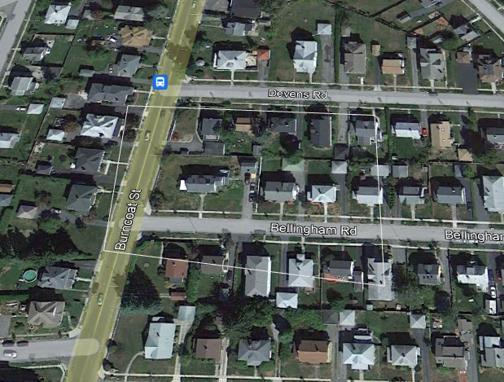
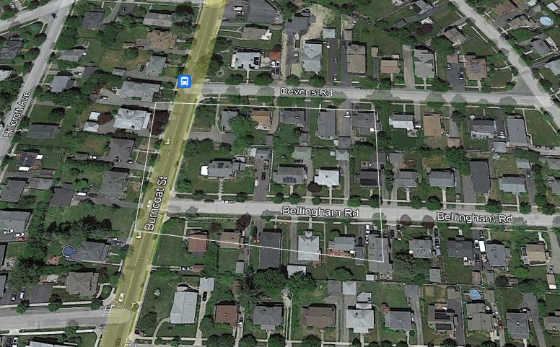
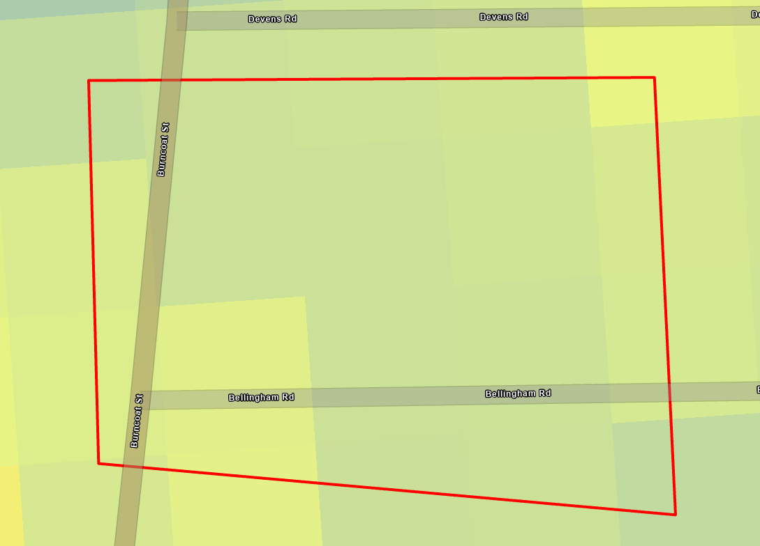
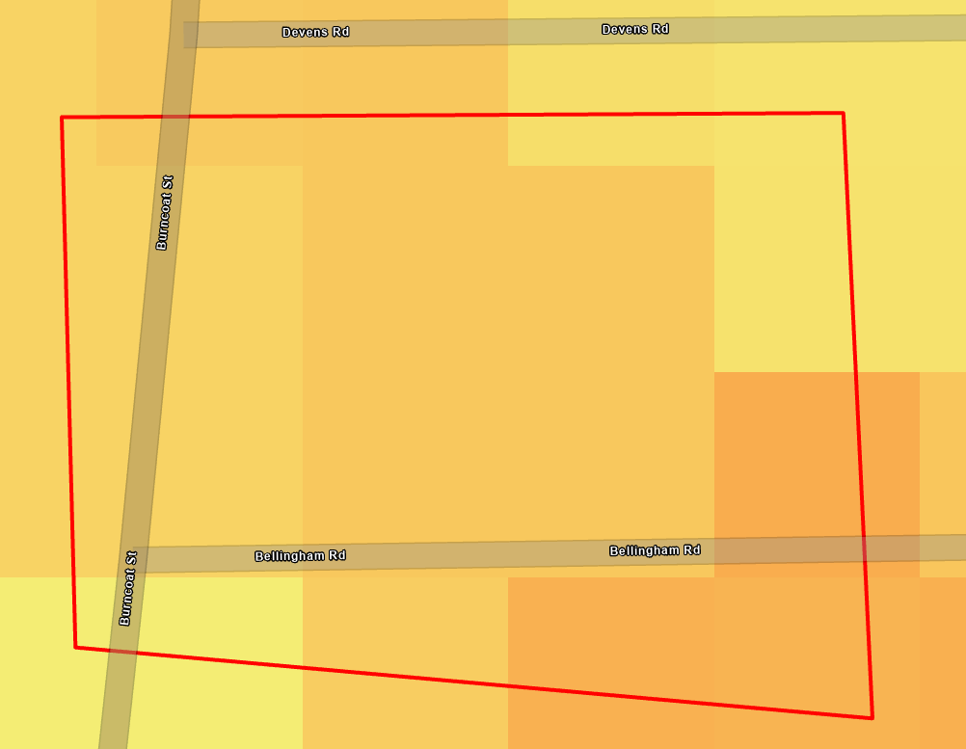
Burncoat Satellite Images vs zLST Difference Maps
7/2007 9/2010 6/2022
Land Surface Temperature (zLST) Difference
2007 - 2009:
2009 - 2022:

Slide 18
Takeaways:
Data collection is important, but can get repetitive. Ways to maintain enthusiasm:
Keep the big picture in mind. Good data is gold. We are mining for gold!
Every single tree is an opportunity to learn something and experience wonder
Fun banter, music, and ice cream stops
LST (Land Surface Temperature) is really cool.
Easy way to understand and visualize the impact of land change.
Can take a long time for trees to grow enough to show up in the data.
Translating findings into policy change can be challenging
Foresters will often have anecdotal understanding of trends, and stick to this intuition whether or not the data supports it.
Institutional knowledge can be lacking. 10 years is a long time.
Quota based tree planting systems should probably change

Slide 19
Thanks for listening!
FINAL SLIDE

